Slide 1

WEEK 3
CARBON CAPTURE AND STORAGE
Lecture 1

Slide 2

TOPIC OUTLINE
Transport of CO2
-Ship Transport
-Pipeline Transport

Slide 3
INTRODUCTION
Captured CO2 can be transported in a number of different ways, including by road tankers and railway, but for the volumes involved in CCS, pipeline and ship are the most practical and economical options.
Extensive experience exists in the transport of CO2 by pipeline, while the use of ships and other carriers is still in its infancy and is so far only applied to small quantities of food grade CO2. However, natural gas, petroleum gas and condensates are routinely transported by all of the mentioned carriers under a wide variety of conditions - including across deserts, mountain ranges, heavily populated areas, arctic areas and in deep sea. Therefore, the transport of CO2 is similar to, and no more challenging than, the transport of hydrocarbon gases.

Slide 4
INTRODUCTION
Pipeline is the most economical method for distances up to 1000-1500 km, depending on specific conditions and the volume transported.
Beyond this distance, transport by ship may be more economical (IPCC, 2005).
At present, no planned CCS projects are based on marine transport of CO2 from the capture site to the storage site, but future projects may require it, particularly if no suitable storage site is found within the vicinity of a large emission source or a cluster of large emission sources.

Slide 5

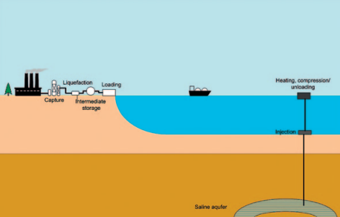
SHIP TRANSPORT
The key elements in ship transport are liquefaction, intermediate storage, loading, unloading (onshore or offshore) and heating. These are illustrated in figure 15. When unloading offshore, a pumping station is needed. Here, the liquid is pumped to injection pressure and heated to ambient temperature, at least 15°C, to avoid hydrate formation before injecting.
.
.

Slide 6
SHIP TRANSPORT
Offshore processing is considered costly and can be avoided by unloading the CO2 from the ship to an onshore hub located close to the offshore storage site. This requires an additional onshore intermediate storage tank, compression and an offshore pipeline.
If the delivery point is onshore, the CO2 is unloaded from the ships into temporary storage tanks. If the delivery point is offshore – as in the ocean storage option – ships might unload to a platform, to a floating storage facility (similar to a floating production and storage facility routinely applied to offshore petroleum production), to a single-buoy mooring or directly to a storage system.

Slide 7

Process-
LOADING
Liquid CO2 is charged from the temporary storage tank to the cargo tank with pumps adapted for high pressure and low temperature CO2 service. The cargo tanks are first filled and pressurized with gaseous CO2 to prevent contamination by humid air and the formation of dry ice.
TRANSPORT TO THE SITE
Heat transfer from the environment through the wall of the cargo tank will boil CO2 and raise the pressure in the tank. It is not dangerous to discharge the CO2 boil-off gas together with the exhaust gas from the ship’s engines, but doing so does, of course, release CO2 to the air. The objective of zero CO2 emissions during the process of capture and storage can be achieved by using a refrigeration unit to capture and liquefy boil-off and exhaust CO2..
UNLOADING
Liquid CO2 is unloaded at the destination site. The volume occupied by liquid CO2 in the cargo tanks is replaced with dry gaseous CO2 , so that humid air does not contaminate the tanks. This CO2 could be recycled and reliquefied when the tank is refilled.
RETURN TO PORT IN BALLAST, AND DRY-DOCKING
The CO2 tanker will return to the port for the next voyage. When the CO2 tanker is in dock for repair or regular inspection, gas CO2 in cargo tank should be purged with air for safe working. For the first loading after docking, cargo tanks should be fully dried, purged and filled with CO2 gas.

Slide 8
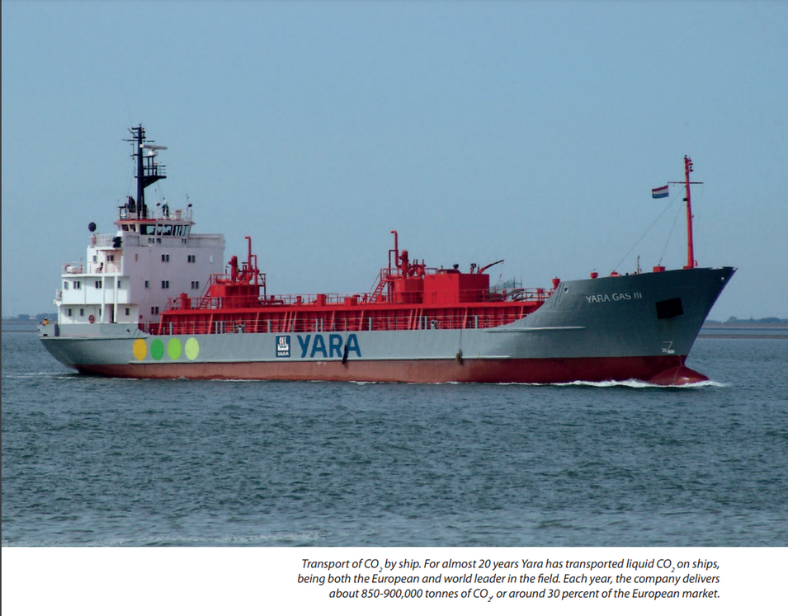
SHIP TRANSPORT
Carbon dioxide tankers are constructed using the same technology as existing liquefied gas carriers. The latest LNG carriers reach more than 200,000 m3 capacity. (Such a vessel could carry 230 kt of liquid CO2 .) The same type of yards that today build LPG and LNG ships can carry out the construction of a CO2 tanker. The actual building time will be from one to two years, depending on considerations such as the ship’s size.

Slide 9
SHIP TRANSPORT
The use of ships for transporting CO2 across the sea is today in an embryonic stage. Worldwide there are only four small ships used for this purpose.
These ships transport liquefied foodgrade CO2 from large point sources of concentrated carbon dioxide such as ammonia plants in northern Europe to coastal distribution terminals in the consuming regions.
From these distribution terminals CO2 is transported to the customers either by tanker trucks or in pressurized cylinders.
Design work is ongoing in Norway and Japan for larger CO2 ships and their associated liquefaction and intermediate storage facilities.

Slide 10
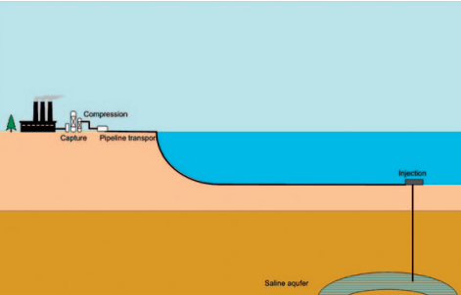
PIPELINE TRANSPORT
Transport of CO2 by pipeline is most effective when the gas is in liquid or supercritical state (dense phase). The reason for this is that the friction loss along the pipeline per mass unit of CO2 is lower compared with its transport as a gas or a two-phase (liquid and gas).
.
.

Slide 11
PIPELINE TRANSPORT
The pressure in the pipeline decreases due to friction and the temperature drops due to heat transfer with the outside medium along the length of the pipeline. The CO2 will gradually move from a supercritical fluid into a liquid, but will still be in single phase. The pressure at the end of the pipeline must be above ~ 74 bar (critical pressure of CO2 ) to ensure that the gas is kept in liquid dense phase.
The initial pressure at the beginning of the pipeline depends on the associated pressure drop over the pipeline length. The pressure drop in the pipeline depends on the flow rate, pipe geometry, pipeline route, and other factors

Slide 12
PIPELINE TRANSPORT
Underwater pipelines are typically constructed using three main methods: lay-barge, reel, and tow/pull.
Lay-Barge Method:.
In the lay-barge method, pipes (typically 12 or 24 meters long) are transported to a barge. On the barge, the pipes are welded one by one to the end of the existing pipeline. The barge then moves forward slowly, and the pipeline is fed off the stern, passing over a support structure known as a ‘stinger’. It descends through the water in a suspended span until it reaches the seabed. This method is commonly used for laying long pipelines in deep water.

Slide 13
PIPELINE TRANSPORT
.2. Reel Method:
For the reel method, the pipeline is assembled and welded onshore before being wound onto a large reel on a ship. At the installation site, the pipeline is unwound from the reel and laid into its final position. This method is suitable for pipelines up to 450 mm in diameter and is typically used for shorter distances.
3.Tow/Pull Methods:
The tow and pull methods involve welding the pipeline together onshore and then towing or pulling it into its final location. These methods are primarily used for short pipelines and shore crossings in shallow water.

Slide 14
PIPELINE TRANSPORT
Trenching is often required and can be done either before or after the pipeline is laid.
What Does Trenching Mean?
Trenching is a construction method that involves digging a narrow trench(a long cut in the ground) for the installation, maintenance, or inspection of pipelines, conduits, or cables.
Refer- Pipeline Trenching Animation-
https://www.youtube.com/watch?v=uhzKZ5q5I80
.

Slide 15
PIPELINE TRANSPORT
–Post-laying trenching is achieved using jetting sleds, ploughs, or mechanical cutters.
–Pre-laying trenching, more common in shore crossings and very shallow water, is performed using dredgers, backhoes, or draglines for soft sediments and blasting followed by clamshell excavators in rocky areas.
Horizontal directional drilling is also used for many shore crossings to avoid the surf zone and minimize environmental impact
Connections underwater are made through mechanical systems, hyperbaric welding, or by lifting and welding the pipe above the surface and then lowering it back.
These construction techniques are well-established, with pipelines up to 1422 mm in diameter and depths of 2200 meters having been constructed. Technological advancements have significantly increased the feasible size and depth of underwater pipelines

Slide 16
PIPELINE TRANSPORT
Pipelines have been used for CO2 transport in the USA for a relatively long time, transporting large volumes to oilfields for EOR. Pipeline infrastructure there has the capacity to carry 50 million tonnes of CO2 a year, and according to experiences, pipeline transport is safe and reliable. Valuable lessons have been learned. For example, gas must be dried before transported through steel pipes to avoid corrosion, and the sulphur level (in the form of hydrogen sulphide, H2 S) must be low in case of leakages, particularly when pipelines go through inhabited areas. Pipelines must be constructed to shut down automatically in case of leakage.
Large compressors are in current use, for example, at the Dakota Coal Gasification plant in North Dakota, where one compresses and delivers 1.2 million tonnes a year to the Weyburn oilfield in Canada (Freund & Kårstad 2007).

